Slide 1

lesson 18
    Networking at Home and Abroad

Slide 2
This lesson includes the following sections:
    Standard Telephone Lines
    Digital Telephone Lines
    Networks in the Home

Slide 3
    Data Communications over Standard
    Telephone Lines
Networks commonly use dedicated media to transmit data. However, the public telephone system can also be used for data communications.
Standard phone lines transmit data much more slowly than network media, but devices such as modems make phone lines practical for data transmission over long distances.
Many people and businesses use modems to exchange data, and to establish connections with office networks.

Slide 4
    Data Communications over Standard
    Telephone Lines - Modems
Most telephone lines attached to home and businesses are analog, not digital.
Because PCs transmit and receive data in digital format, a device called a modem is needed to convert digital data to analog format for transmission over phone lines.
When receiving data from another computer, the modem converts it from analog format to digital format.

Slide 5
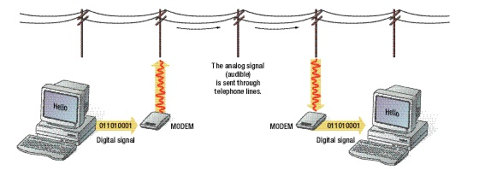
The analog signal
(audible)
is sent through
telephone lines.
011010001
MODEM
MODEM
011010001
Digital signal
Digital signal
This modem converts
digital to analog.
This modem converts
analog to digital.

Slide 6
    Data Communications over Standard Telephone Lines - Choosing a Modem
When choosing a modem, consider the following factors:
Transmission speed - the speed at which the modem sends data - which is measured in bits per second.
Data compression, the technology the modem uses to shrink data so it can be transmitted faster.
Error correction, the method the modem uses to ensure data is sent and received without errors.
Internal versus external, which describes whether or not the modem fits inside the PC case.

Slide 7
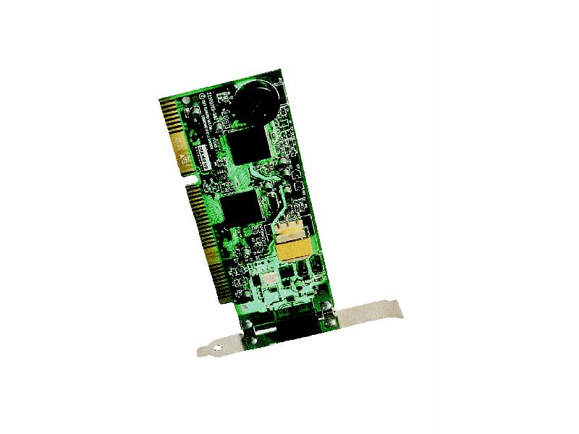
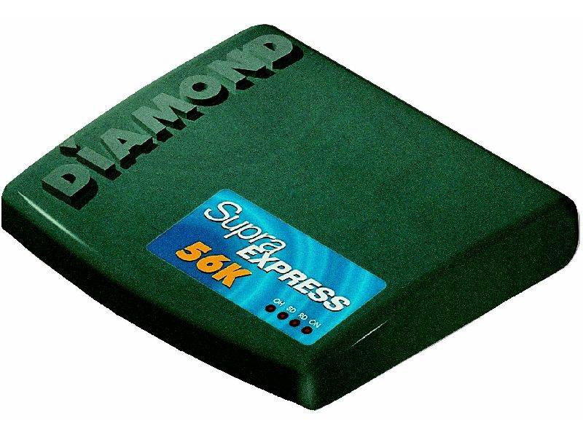
Internal Modem
External Modem

Slide 8
    Data Communications over Standard Telephone Lines - Uses for a Modem
Modems are primarily used for file transfer, or sending files to a remote computer
Sending a file to another computer is called uploading.
Receiving a file from another computer is called downloading.

Slide 9
Using Digital Telephone Lines
Telephone companies are now installing digital telephone lines, which are dedicated to transmitting data in digital format.
Digital phone lines transmit data at much higher speeds than standard analog phone lines.
Often, data travels across analog lines and digital lines. In such cases, data may need to be converted from one format to another multiple times before reaching its destination.

Slide 10
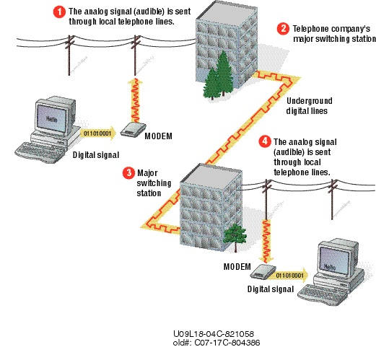
1
1
2
2
4
3
3
4

Slide 11
Using Digital Telephone Lines -
Common Digital Services
The most commonly used digital telephone services are:
ISDN, T1, and T3
DSL
ATM
Cable Modem

Slide 12
Using Digital Telephone Lines –
ISDN, T1, and T3
Integrated Services Digital Network (ISDN) is a system that replaces analog phone services with digital services.
Basic rate ISDN (BRI) offers three channels on one phone line: two for data and one for control. BRI transmits data up to 128 Kbps.
Primary rate ISDN (PRI) offers 24 channels at transmission speeds up to 1.544 Mbps. This is T1 service.
Using even more channels, T3 service offers up to 672 channels and speeds up to 44.736 Mbps.

Slide 13
Using Digital Telephone Lines -
DSL Technologies
Digital Subscriber Line (DSL) service is outpacing ISDN services.
Standard DSL offers speeds of 52 Mbps using standard phone lines.
Several types of DSL service are available, reaching transmission speeds up to 51.84 Mbps.

Slide 14
Using Digital Telephone Lines - ATM
Asynchronous transfer mode (ATM) digital service is offered as a high-bandwidth, efficient means for transferring multimedia content, data, and voice over phone lines.
Some types of ATM service can reach transmission speeds of 10,000 Mbps.

Slide 15
Using Digital Telephone Lines -
Cable Modem Connections
Cable modems allow users to connect their PCs to the Internet via the local cable television system.
Cable companies offer Internet service by combining television and data signals and distributing them over the cable system.
Cable modem service can achieve speeds of 27 Mbps.

Slide 16
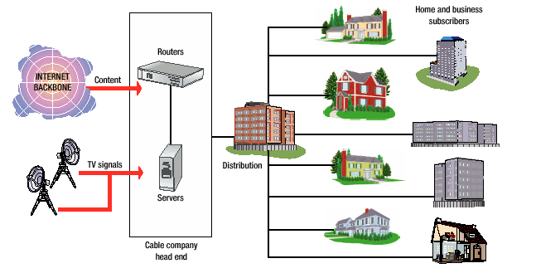
Home and Business
Subscribers
Routers
Internet
Backbone
TV
signals
Distribution
Servers
Cable Company
Head End

Slide 17
Networks in the Home
Because more homes now have multiple computers, home networks are gaining in popularity. Home networks offer the same advantages to home users as to a business.
Home networks are typically based on existing telephone or wireless technologies.
Popular PC operating systems, such as Windows and the Mac OS, provide simple networking tools that are adequate for running a home network.

Slide 18
lesson 18 review
Explain how computer data travels over telephone lines.
Explain a modem's function.
List four features you should consider when evaluating modems.
Differentiate four types of digital telephone services.
Describe one potential use for a home network.
.

